Slide 1

Blood Donation
Database
Nguyễn Như Đại
Trần Trọng Kỳ
Nguyễn Đình Hồng Phong
Vũ Minh Tuệ
20215194
20194784
20215233
20215252

Slide 2
Our Team
Nguyễn
Như Đại
Trần Trọng Kỳ
Nguyễn Đình Hồng Phong
Vũ Minh Tuệ
Mercury is the closest planet to the Sun
Venus is the second planet from the Sun
Earth is the third planet from the Sun
Despite being red, Mars is a cold place

Slide 3
Overview
Project: Blood Donation
Description:
This is a website mainly allows users either book appointments to donate their blood or request to receive blood.
The request from users then will be verified by admins.
There are also many others feature like view history, giving gift for users ...

Slide 4
Organization
Assigned tasks:
Phong:
Design UI, Front End Web interface.
Write queries for authorizing admin and user, authenticating for user login.
Write queries for choosing a location has enough blood units for certain blood type.
Write queries for calculating statistics related to number of people request or donate

Slide 5
Organization
Assigned tasks:
Ky:
Write queries for statistic of each blood type, filtered by location
Write queries for gift exchange
Write queries for enumerating user's information
Explore specific information for blood donation, like number of blood units for male and female, matching blood type, ...

Slide 6
Organization
Assigned tasks:
Tue:
Write queries return history of requests, donations (user)
Write queries updating information when it is pending
Write queries view history of requests, donations for admin
Fixing UI when adding more features

Slide 7
Organization
Assigned tasks:
Dai:
Write queries inserting when users send request, updating status of requests when admin modified
Write queries counting total number of donations
Search information about diseases related to blood
Write trigger when admin approved a pending request

Slide 8
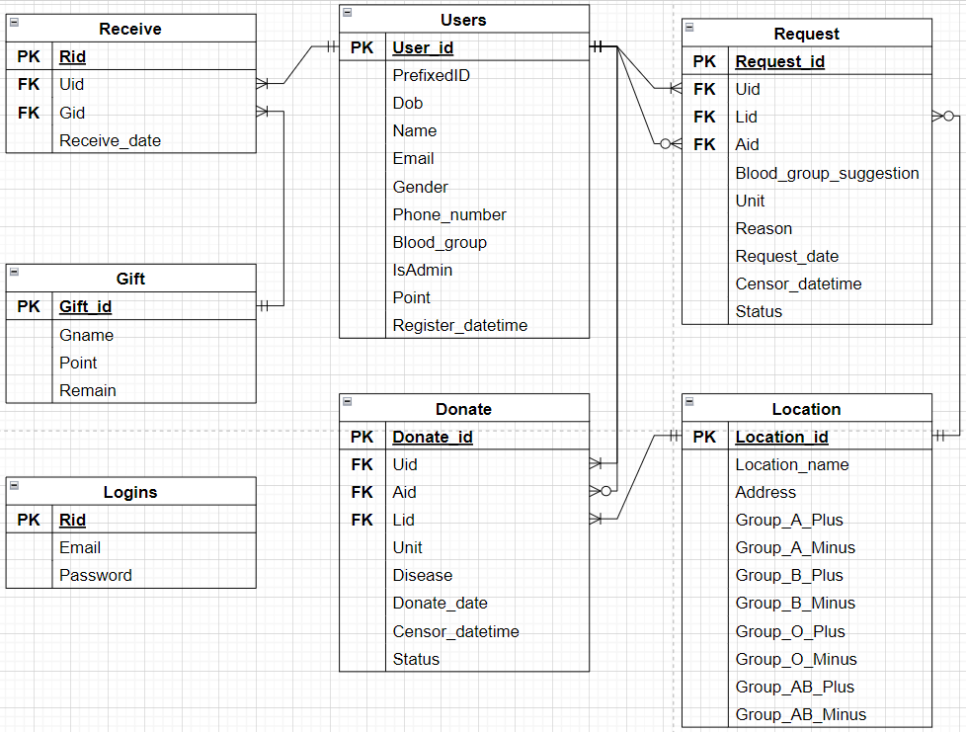
Database Design
In Users:
Phone_number must be a 10-number-digit
Blood_group must be in (A+, A-, B+, B-, O+, O-, AB+, AB-)
DOB must be before the current date
Point is 0 by default
Register_datetime is the current datetime by default
IsAdmin is bit type and is 0 by default
In Donate & Request:
Status must be in (pending, rejected, approved)

Slide 9
Database Design: Trigger
In Donate & Request:
When a record is updated and its Status is not pending, update Censor_datetime as the current datetime
In Receive:
When a record is inserted into the table, update Receive_date as the current date
Users-Request, Donate: 1-n
Location-Request, Donate: 1-n
Users-Receive: 1-n
Receive–Gift: 1-n

Slide 10
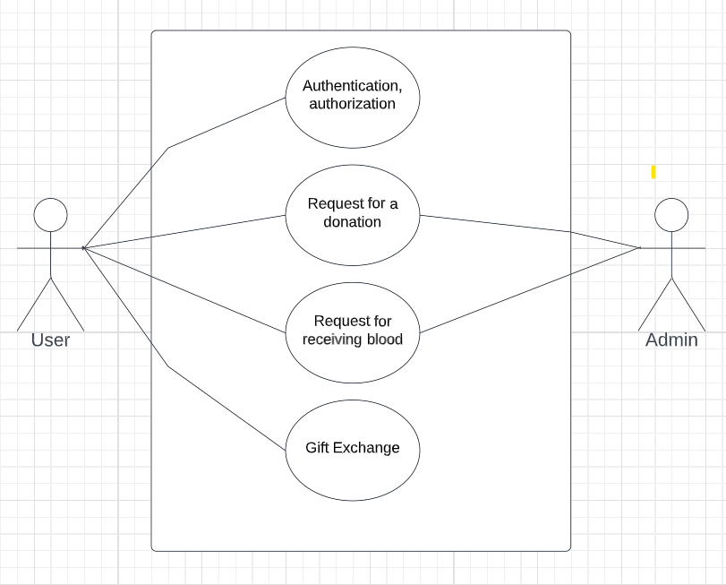
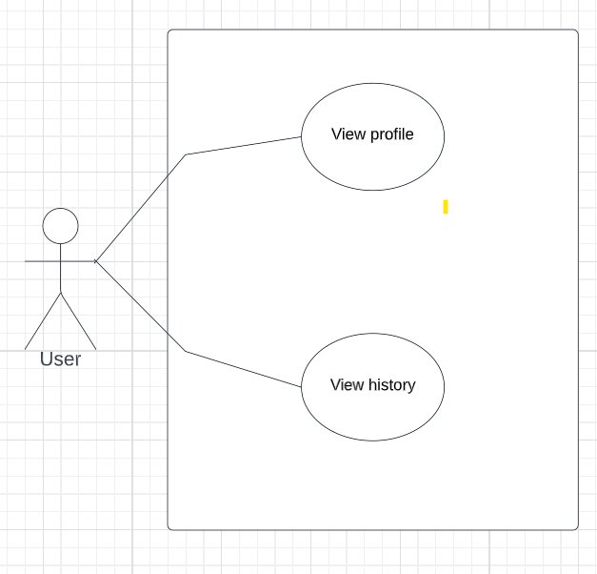
Functionalities
Use case diagram

Slide 11



Result Web

Slide 12
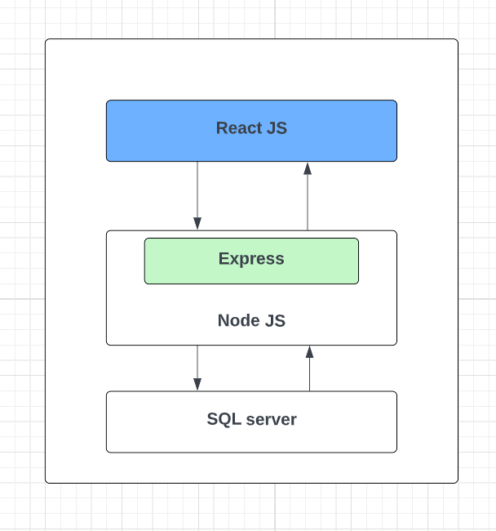
Architecture
3-tier
Front end – using React JS
Server – using Express
Framework, NodeJS
Database: SQL server

Slide 13
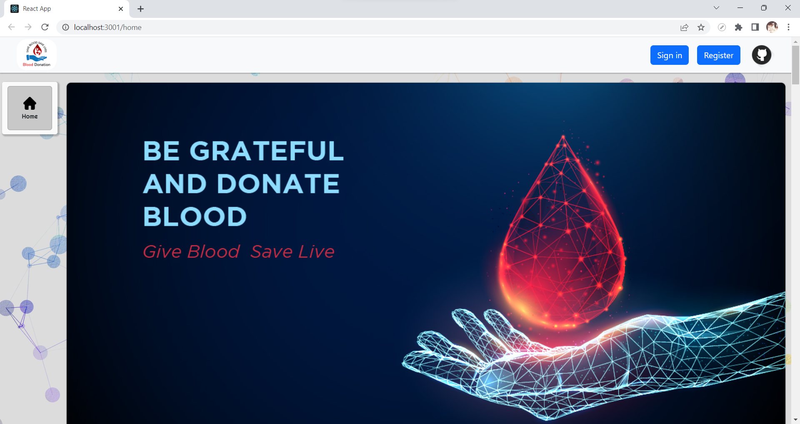
Result Web

Slide 14
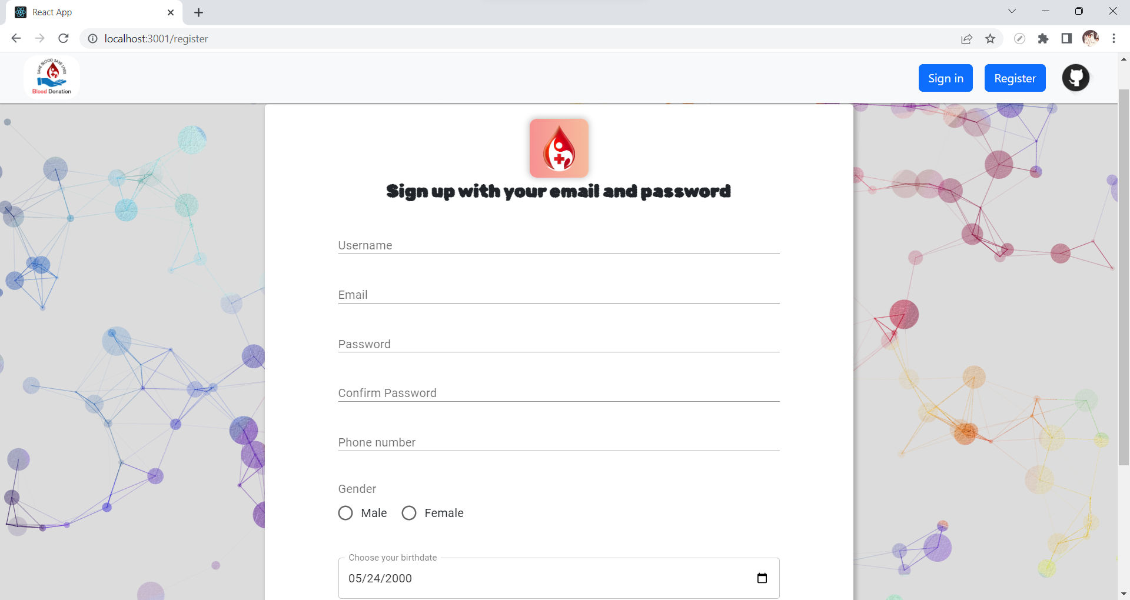
Result Web

Slide 15
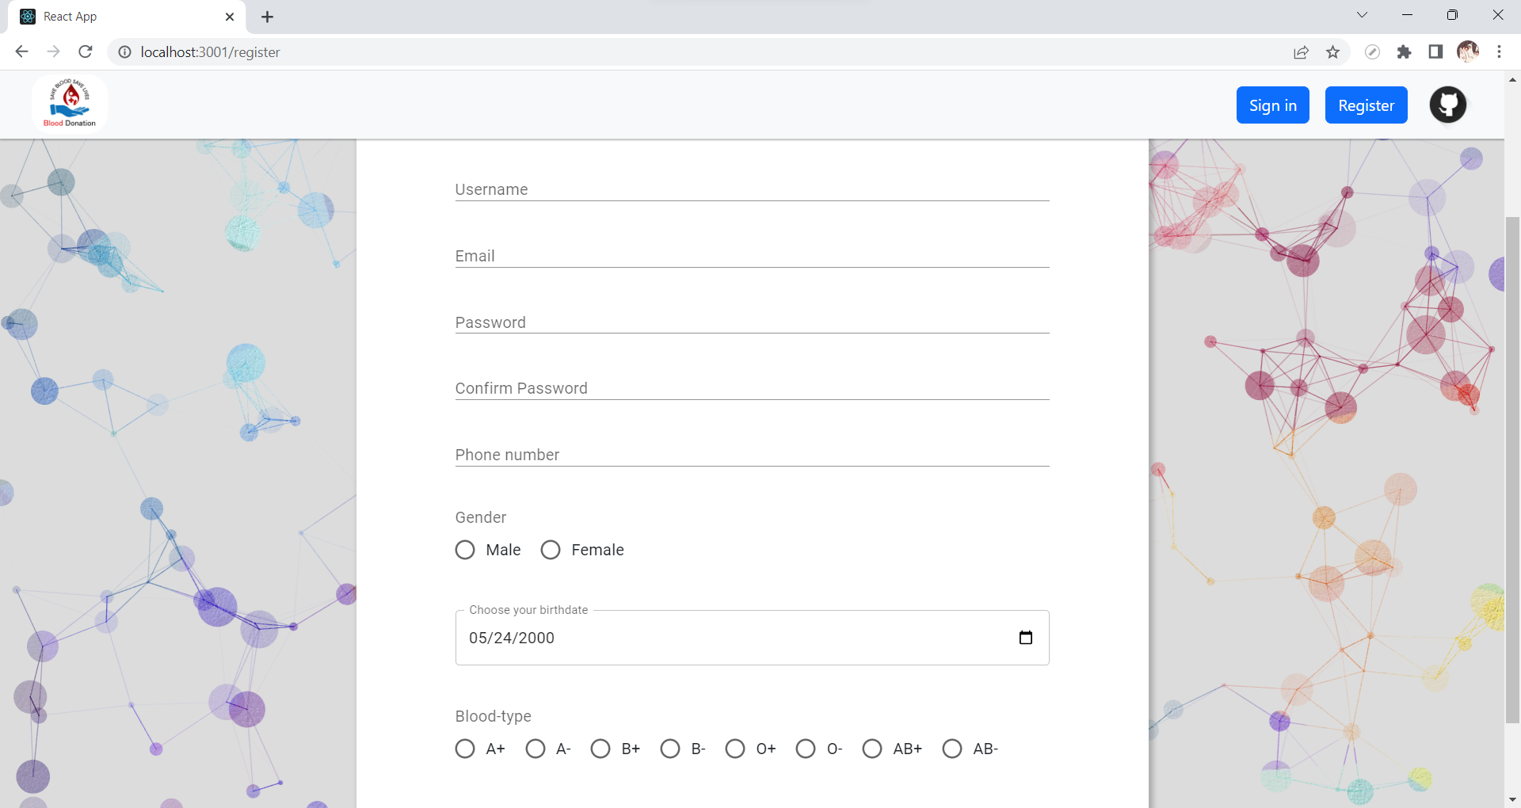
Result Web

Slide 16
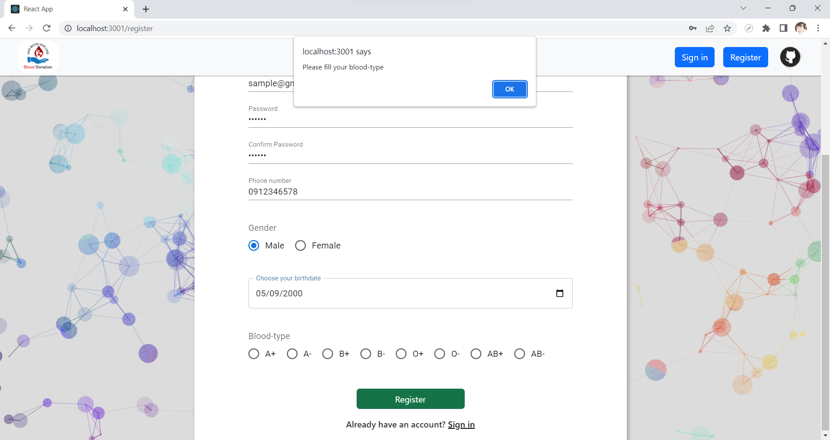
Result Web

Slide 17
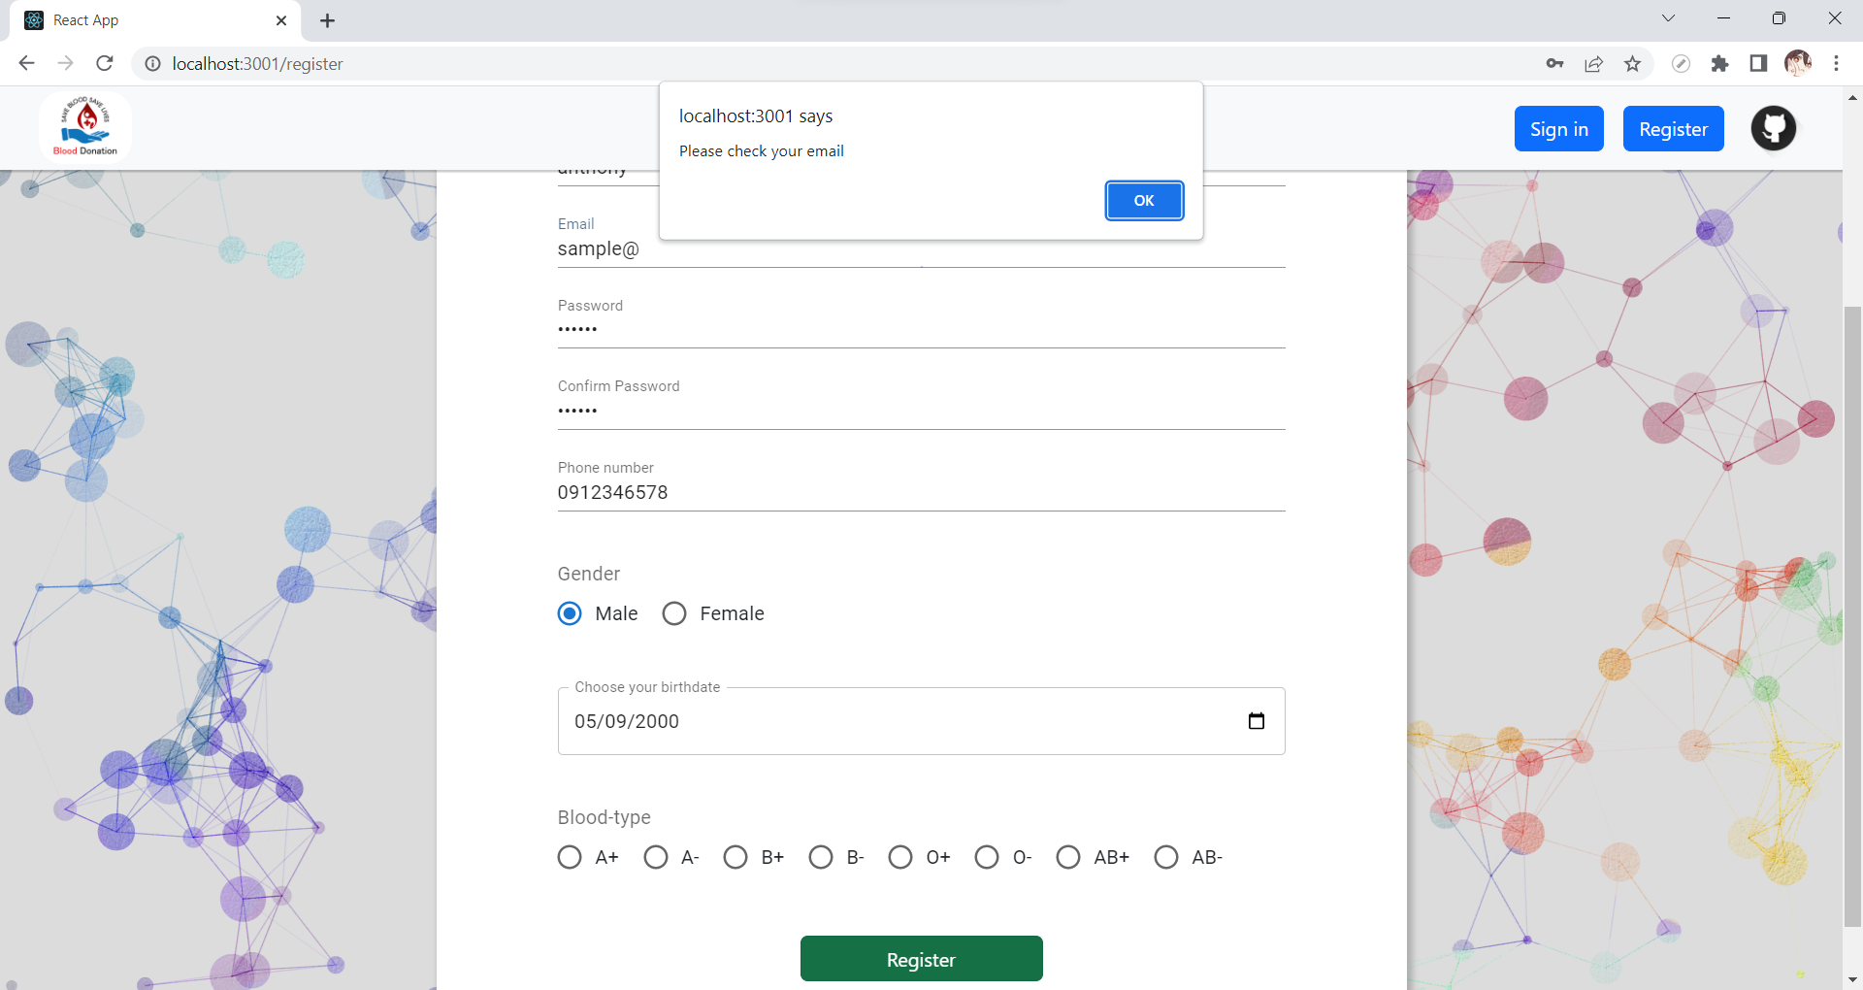
Result Web

Slide 18
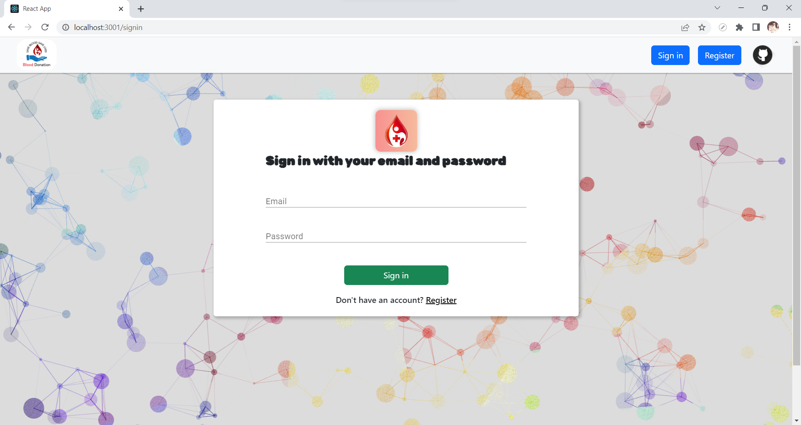
Result Web

Slide 19
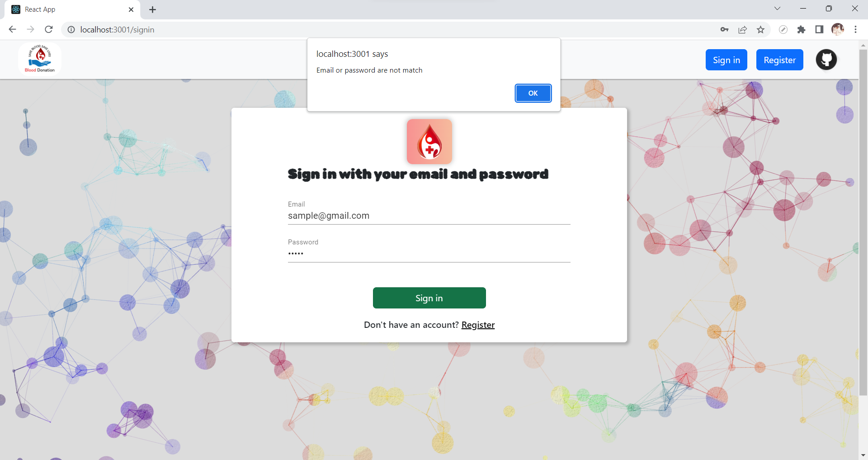
Result Web

Slide 20

Result Web: Users View

Slide 21
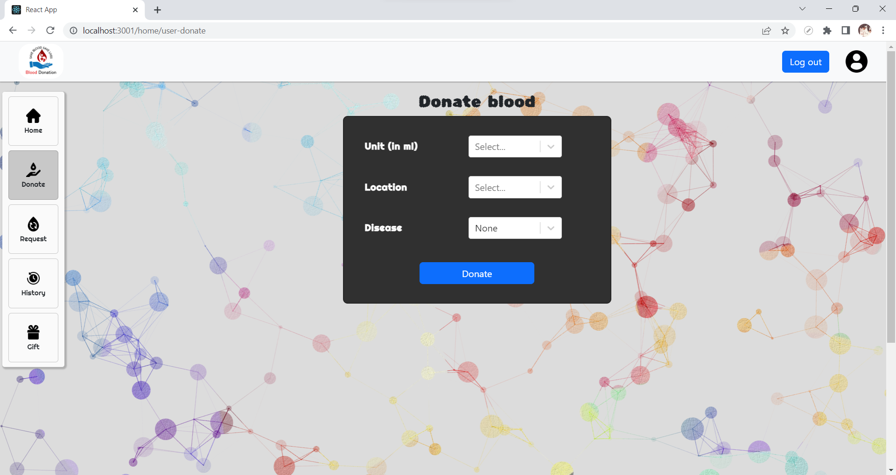
Result Web: Users View

Slide 22
Result Web: Users View
Choose between 250, 350, or 450
Choose between a set of available locations
Choose between None, or Have

Slide 23
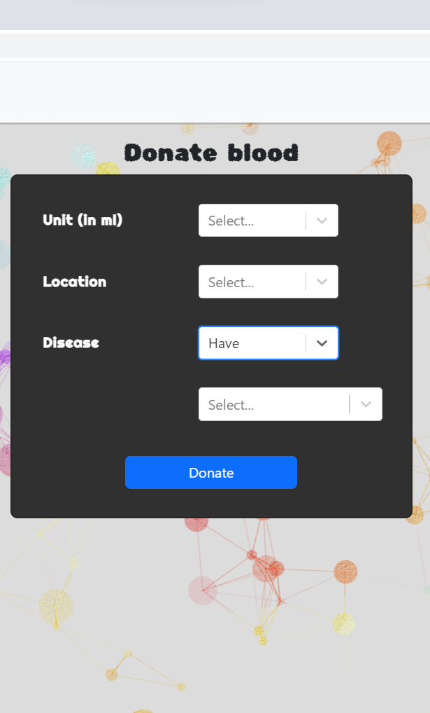
Result Web: Users View
Choose between 250, 350, or 450
Choose between a set of available locations
Choose between None, or Have
If Have is chosen, user can choose between of set of diseases

Slide 24
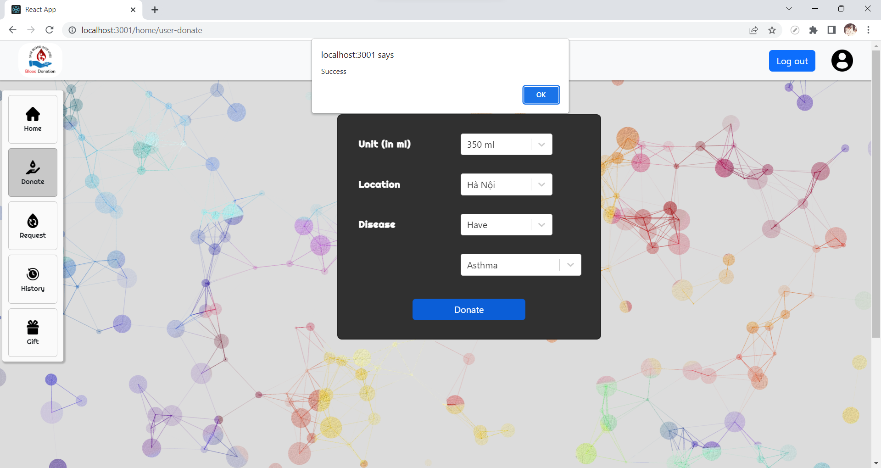
Result Web: Users View

Slide 25
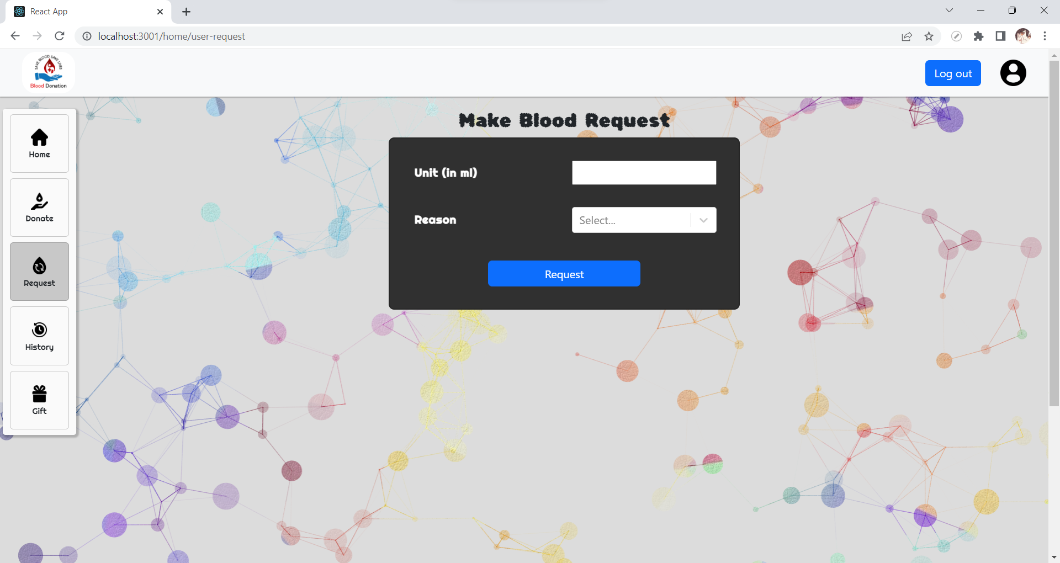
Result Web: Users View

Slide 26
Result Web: Users View
Type in any integer
Choose between a set of diseases

Slide 27
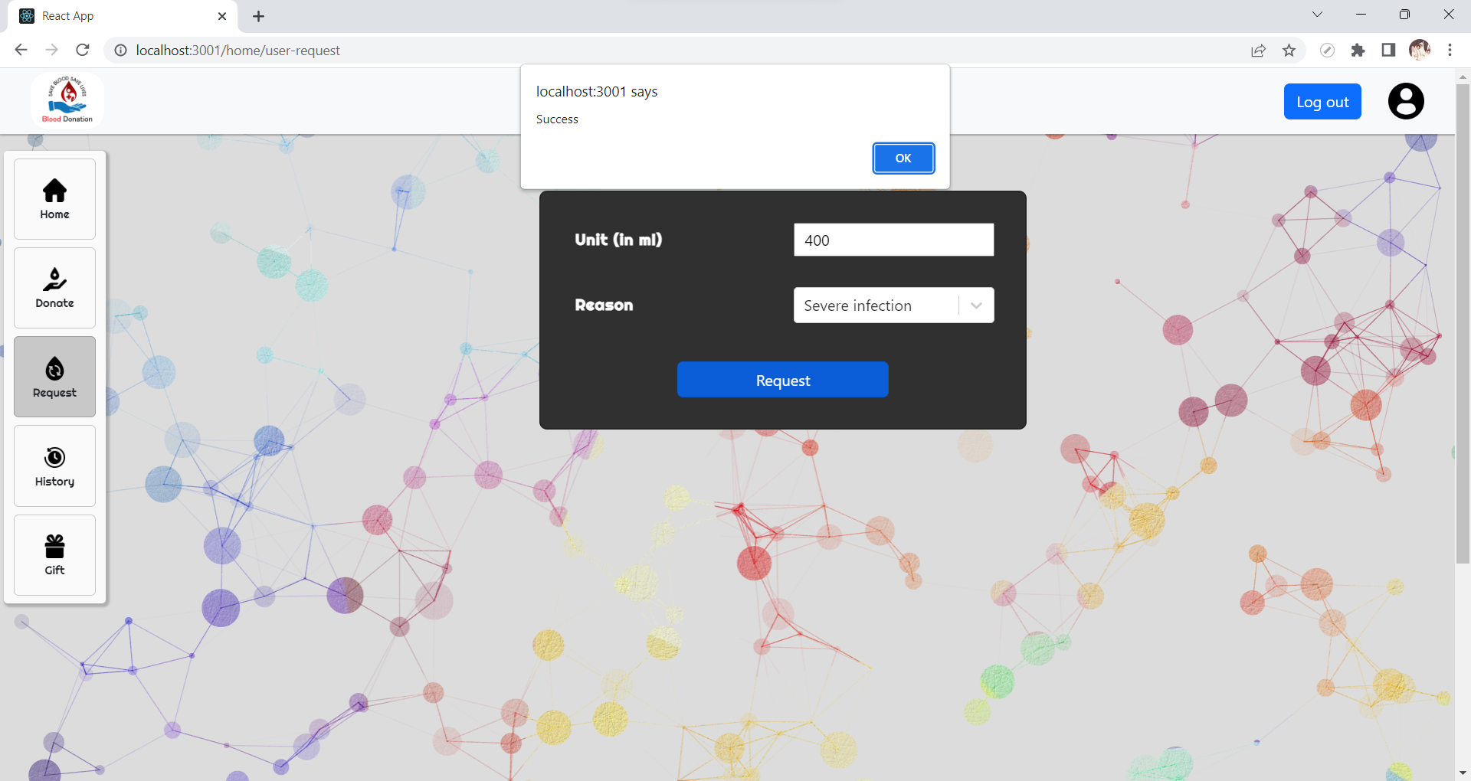
Result Web: Users View

Slide 28
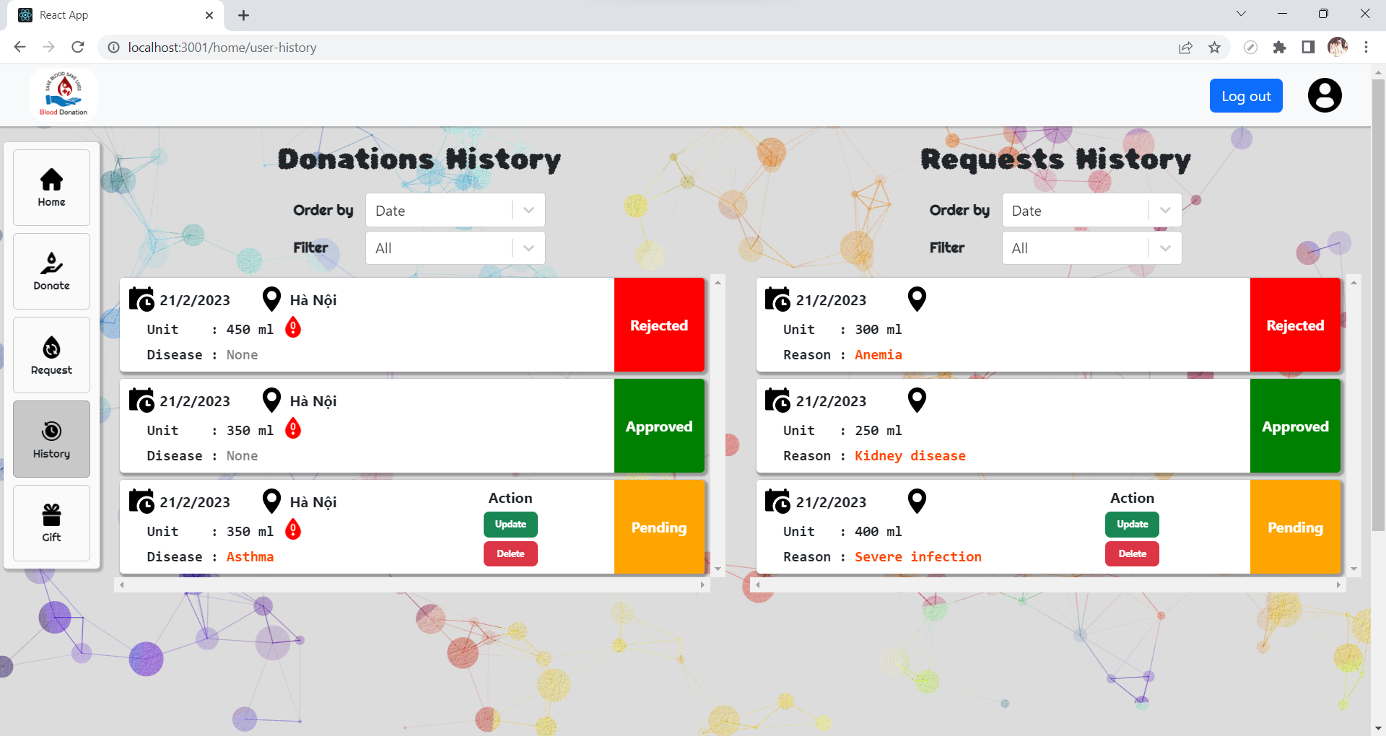
Result Web: Users View
select * from Donate
where Uid = @uid order by ${order}
select * from Donate
where Uid = @uid
and ${field} = '${content}’
order by ${order}

Slide 29
Result Web: Users View
Choose only records whose status is pending/rejected/approved, or without disease
If its status is pending, user can Update or Delete their Donate record

Slide 30
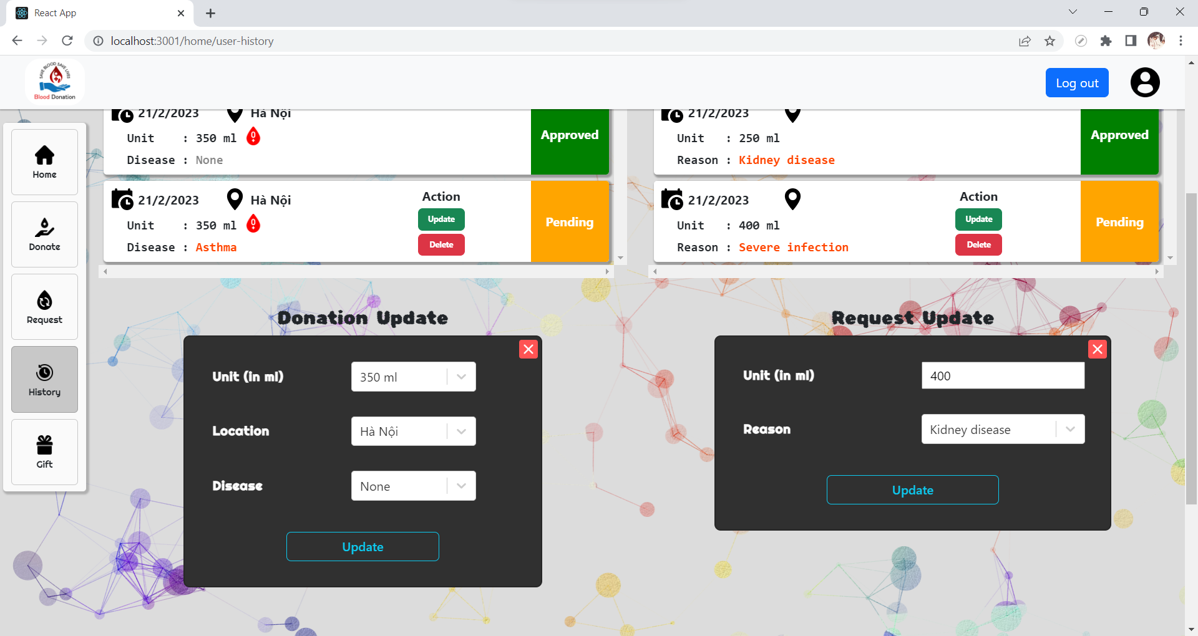
Result Web: Users View
If its status is pending, user can Update or Delete their Donate record
update Request
set Unit = ${unit}, Reason='${reason}' where Request_id = ${request_id}
If Update is clicked on, a form will pop up and user can change any earlier information

Slide 31
Result Web: Users View
Choose only records whose status is pending/rejected/approved
If its status is pending, user can Update or Delete their Request record

Slide 32
Result Web: Users View
If its status is pending, user can Update or Delete their Request record
If Update is clicked on, a form will pop up and user can change any earlier information

Slide 33
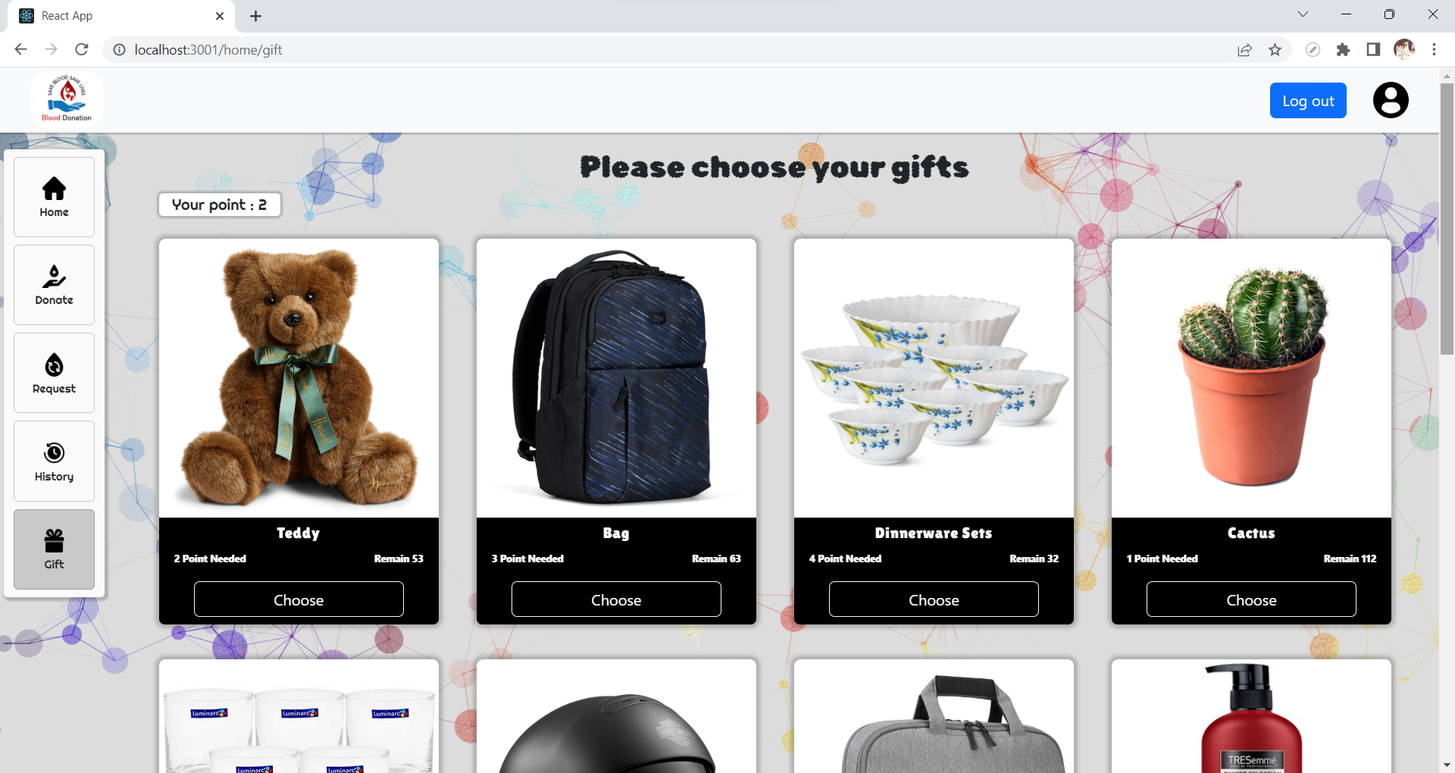
Result Web: Users View
select Gift_id, Gname, Point, Remain
from Gift

Slide 34
Result Web: Users View
Donate.unit = | 250 → users.point + 1 350 → users.point + 2 450 → users.point + 3
User can choose a gift if they have sufficient point

Slide 35
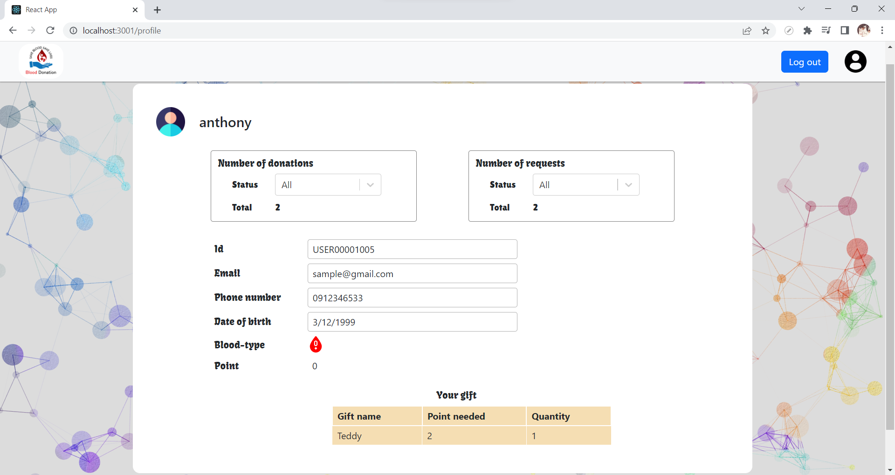
Result Web: Users View

Slide 36
Result Web: Users View
Filter only records with pending/rejected/approved status

Slide 37
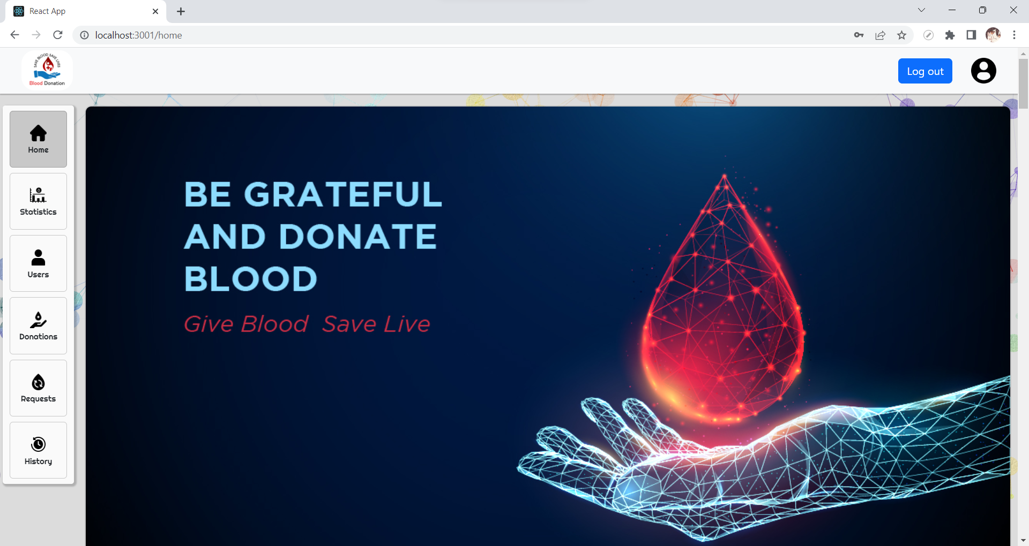
Result Web: Admin View

Slide 38
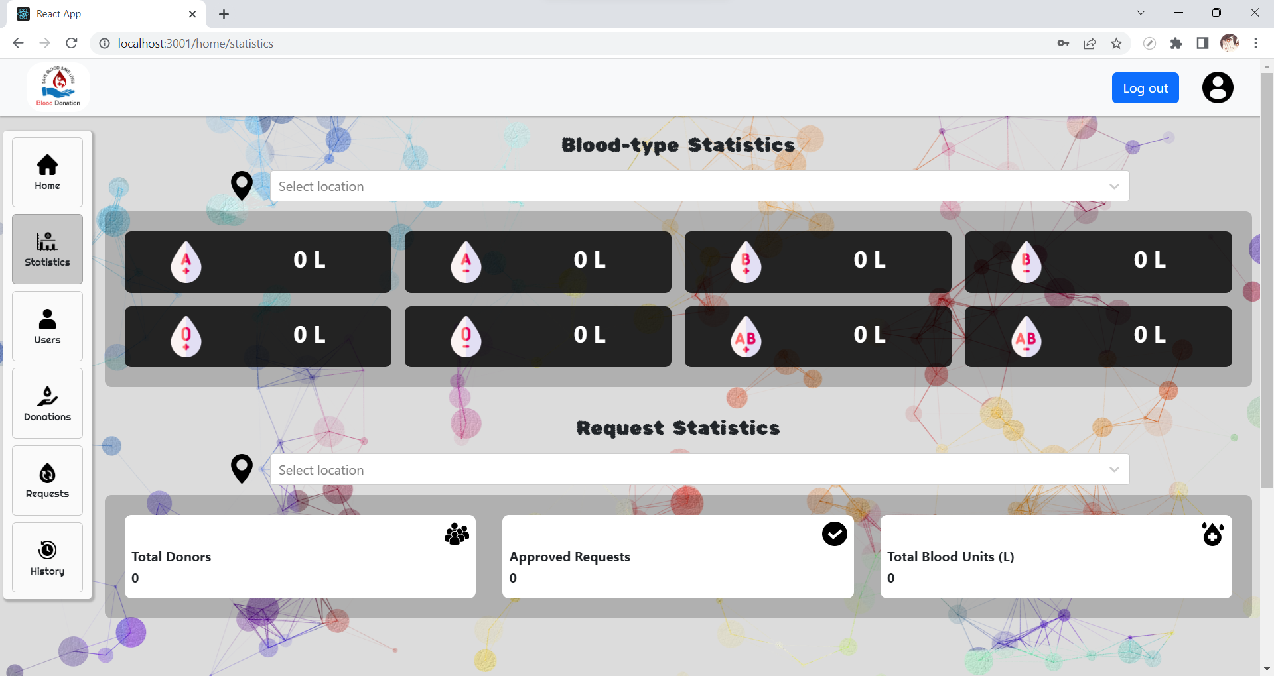
Result Web: Admin View

Slide 39
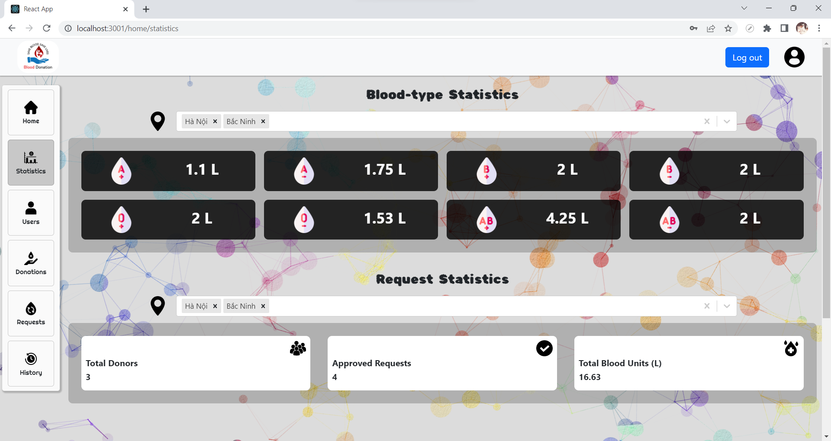
Result Web: Admin View
Show the total amount of each blood type in the locations mentioned in the filter above
Show the statistics in the locations mentioned in the filter above

Slide 40
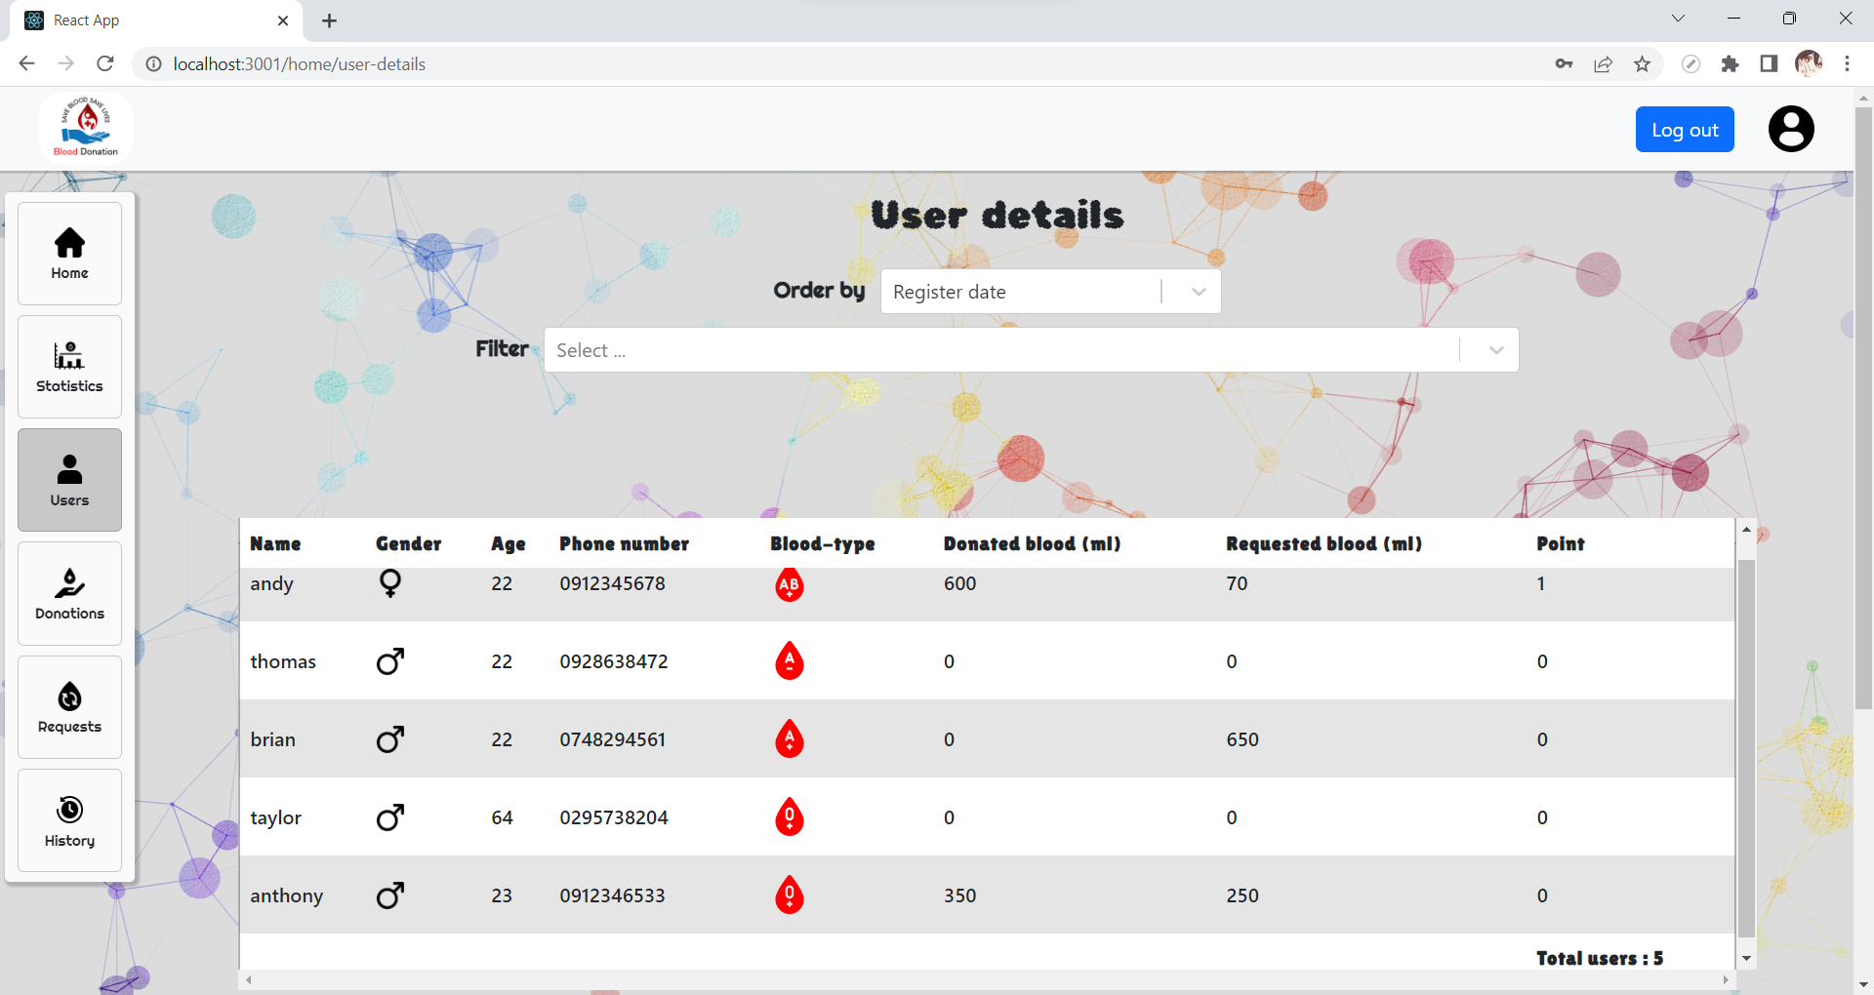
Result Web: Admin View
Can select to show the statistics ordered by:
Register date
Name
Age
Amount of blood donated
Amount of blood received
Point
Can select to filter the statistics by:
Blood type
Age (Under 18, 18 to 60, or over 60)
Donate location
Received location
Over an amount of blood donated
Over an amount of blood received

Slide 41
Result Web: Admin View
Can select to show the statistics ordered by:
Register date
Name
Age
Amount of blood donated
Amount of blood received
Point
Can select to filter the statistics by:
Blood type
Age (Under 18, 18 to 60, or over 60)
Donate location
Received location
Over an amount of blood donated
Over an amount of blood received

Slide 42
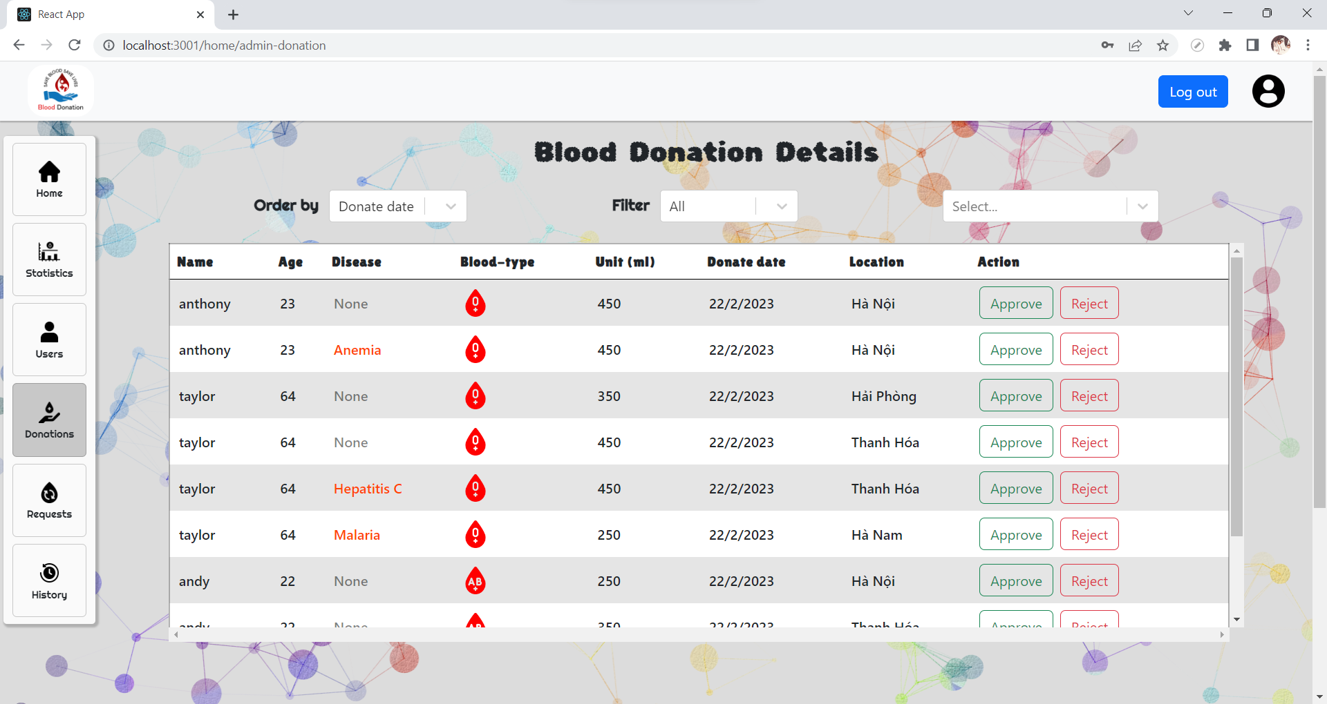
Result Web: Admin View
Admin can approve or reject a pending Donate
The statistics can be shown ordered by Donate date or User Name
The statistics can be filtered by Disease, Location, or Blood type

Slide 43
Result Web: Admin View
Admin can approve or reject a pending Donate
The statistics can be shown ordered by Donate date or User Name
The statistics can be filtered by Disease, Location, or Blood type

Slide 44
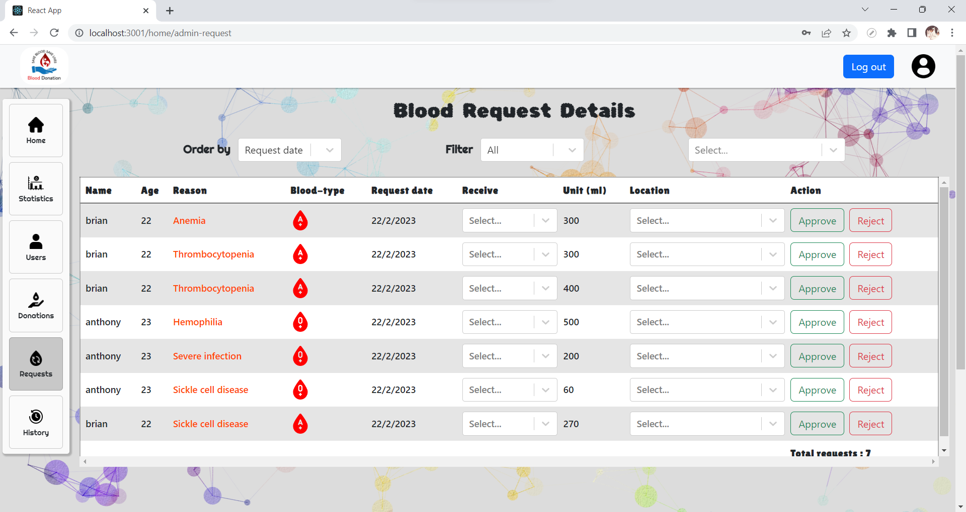
Result Web: Admin View
Admin can approve or reject a pending Request
In order to approve a Request, admin is required to select which blood type and location said user will receive their Request
The statistics can be shown ordered by Donate date or User Name
The statistics can be filtered by Reason or Blood type

Slide 45
Result Web: Admin View
Admin can approve or reject a pending Request
In order to approve a Request, admin is required to select which blood type and location said user will receive their Request
The statistics can be shown ordered by Donate date or User Name
The statistics can be filtered by Reason or Blood type

Slide 46
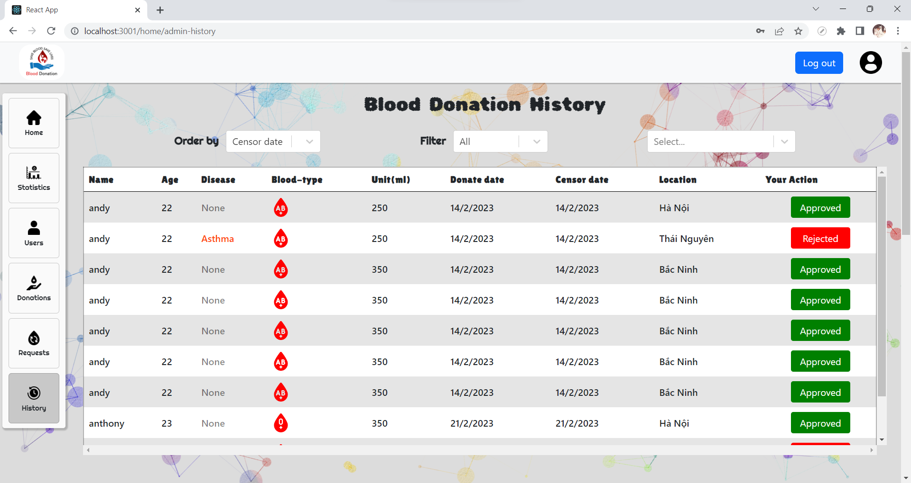
Result Web: Admin View
The statistics can be shown ordered by Censor Date, Donate Date, User Name, or Age
The statistics can be filtered by Disease, Location, Blood type, or Admin’s Action (Approved or Rejected)

Slide 47
Result Web: Admin View
The statistics can be shown ordered by Censor Date, Donate Date, User Name, or Age
The statistics can be filtered by Disease, Location, Blood type, or Admin’s Action (Approved or Rejected)

Slide 48
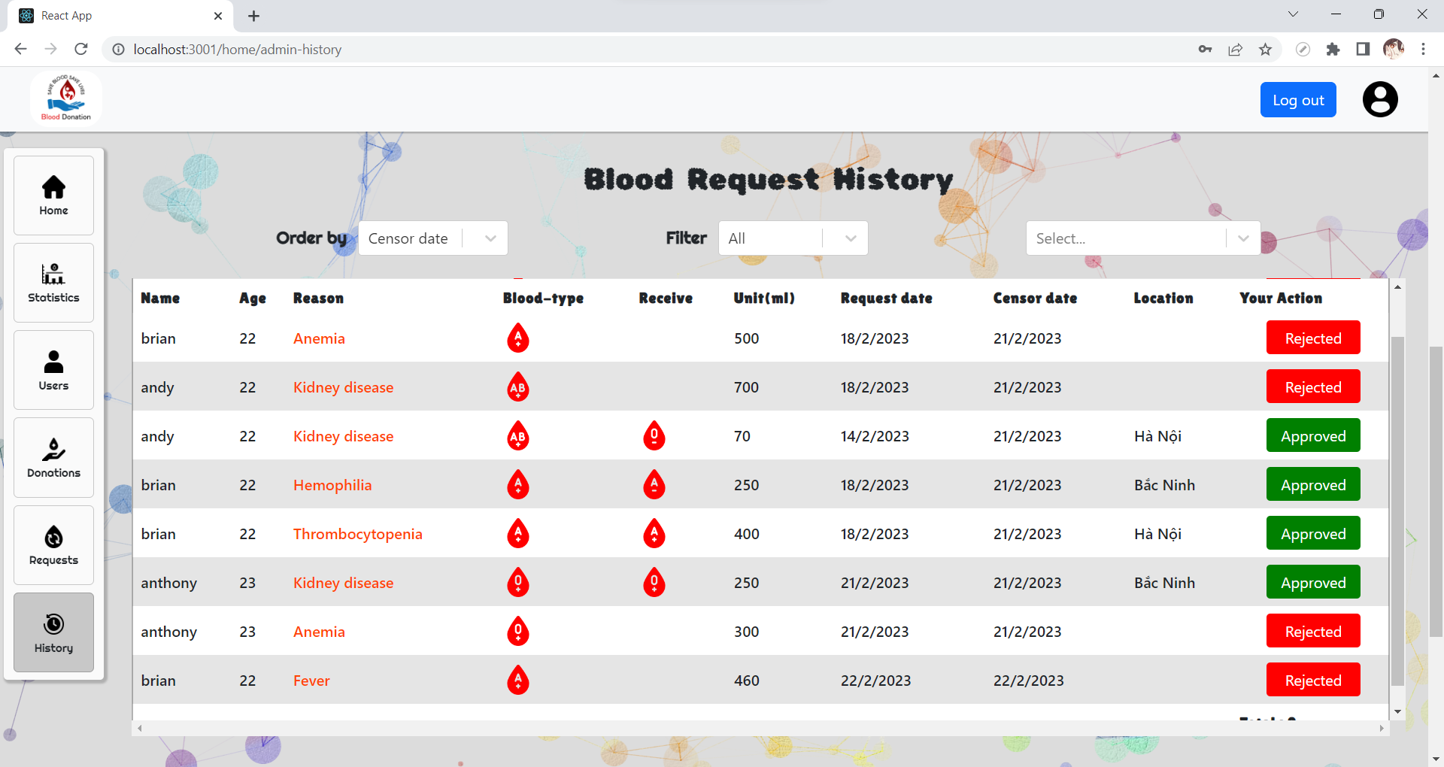
Result Web: Admin View
The statistics can be shown ordered by Censor Date, Donate Date, User Name, or Age
The statistics can be filtered by Reason, Location, Blood type, Received Blood type, or Admin’s Action (Approved or Rejected)

Slide 49
Result Web: Admin View
The statistics can be shown ordered by Censor Date, Donate Date, User Name, or Age
The statistics can be filtered by Reason, Location, Blood type, Received Blood type, or Admin’s Action (Approved or Rejected)

Slide 50
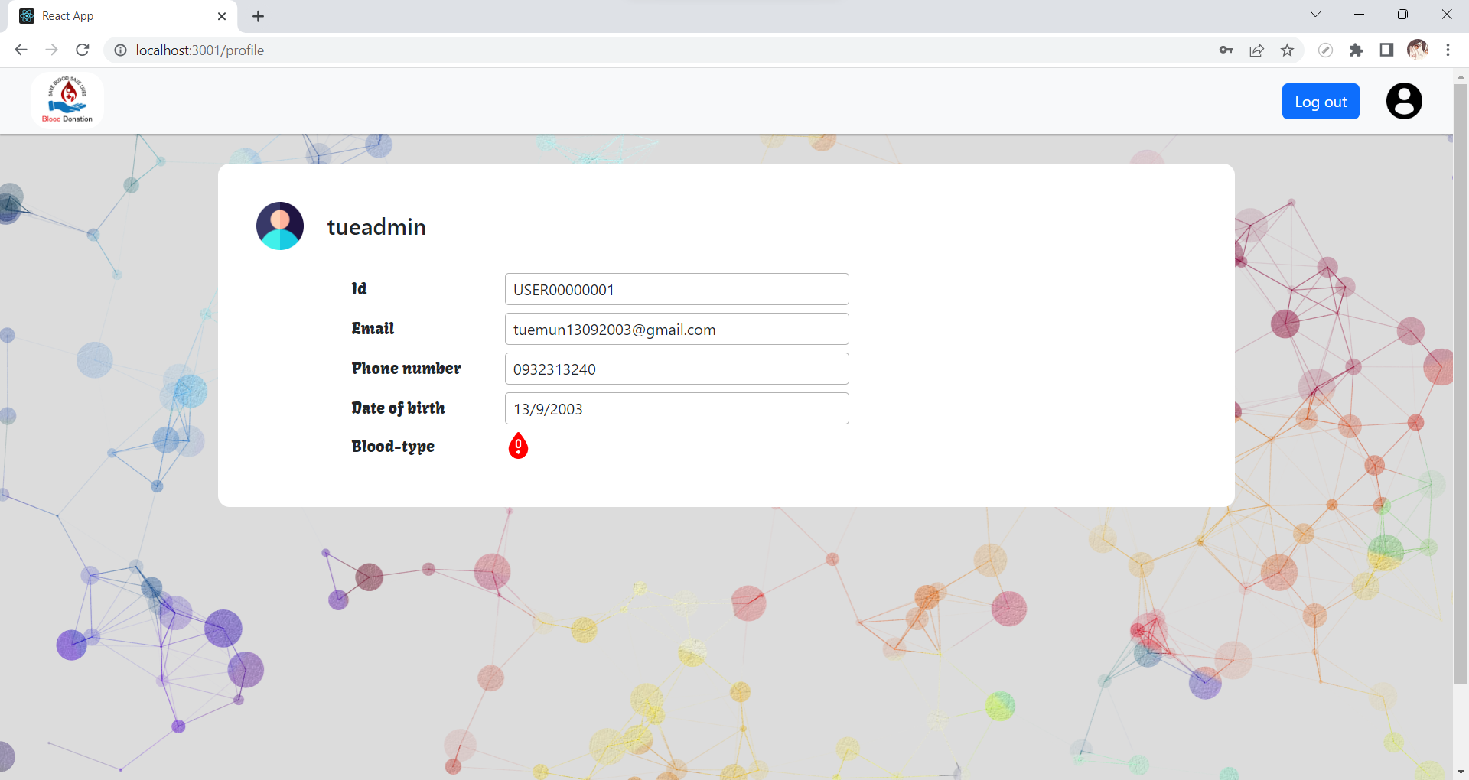
Result Web: Admin View

Slide 51
THANK YOU !

